Slide 1

ML 101 Course
Arush Garg
AI and Machine Learning Club
Overseas Family School

Slide 2
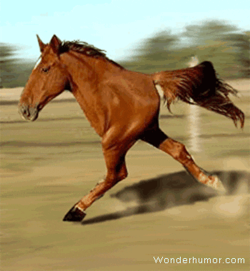

Course (bit.ly/ML_101)
Introduction to Machine Learning (ML)
Regression
Core ML Concepts
Classification
Decision Trees
Model selection and tuning
Unstructured data: Text
Neural Networks
Unstructured data: Images
Introduction to Deep Learning
Beyond Regression & Classification
Notes:
Welcome back to the final lesson of the ML 101 course. Today we will explore concepts beyond supervised learning, including Unsupervised learning and generative models.

Slide 3
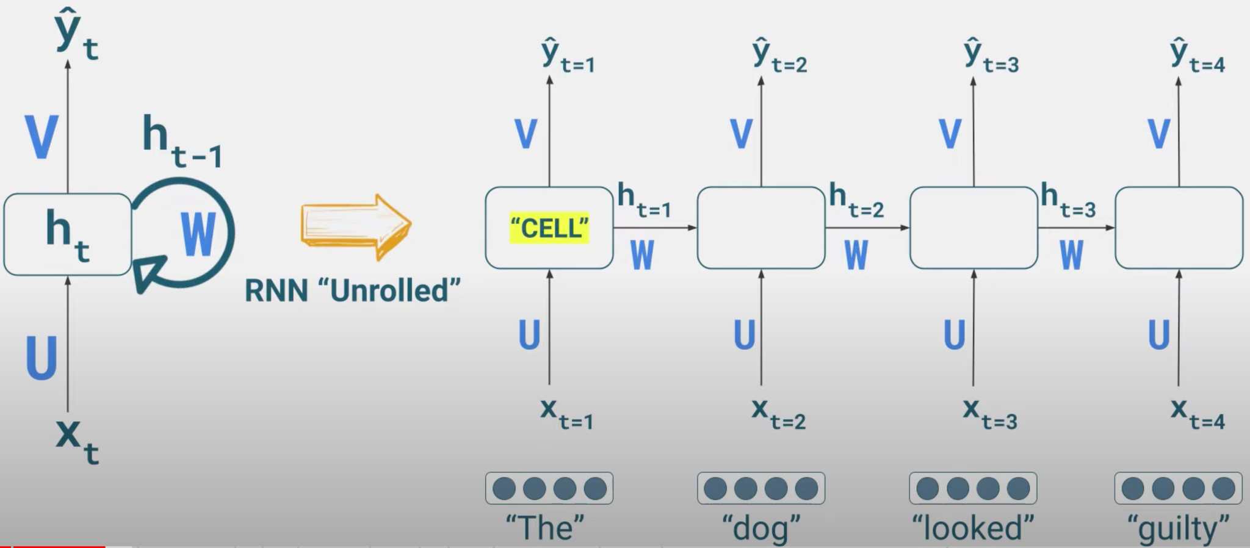
Recap
Supervised Learning
Feed ML algorithm with training data and “labels”. Model learns to predict the label.
Classification (predict class), Regression (predict value)
Classical ML
Simpler models, smaller data sets, requires less compute power
Deep Learning
Neural Networks with multiple hidden layers, the model takes care of “feature extraction”. Very effective for unstructured data
ANNs: fully connected neural networks
CNNs: convolution neural networks, very effective for Image input
RNNs: recurrent neural networks, very effective for text input where “context” matters. E.g. language models
Recurrent Neural Network (RNN)
Notes:
So far we have covered Supervised Learning algorithms. In all these examples the training data was accompanied by “true labels” and we expected the ML algorithm to learn how to predict those labels accurately for unseen data.
We started with some simpler ML models like Linear Regression, Logistic Regression and Decision Trees.
Eventually we learnt about Neural Networks and how Deep Learning has proven to be a game changer, especially for problems involving unstructured data like text or images

Slide 4
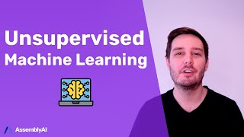
Unsupervised Learning
Clustering
Anomaly Detection
Dimensionality Reduction
Generative AI
Recommender Systems
AssembyAI
Notes:
Now let’s understand Unsupervised Learning
(click to play video)

Slide 5
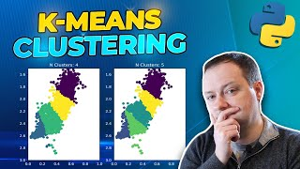
K-means Clustering
Andy McDonald
Notes:
K-means clustering is one of the most popular algorithms used for Clustering.
This is not to be confused with K-nearest neighbors algorithm we learnt under Supervised learning. Both leverage the concept of “nearest neighbor” but are still very different algorithms.
(click to play video)

Slide 6
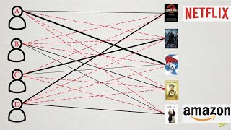
Recommender Systems
Art of the Problem
Notes:
In today’s world we come across recommender systems everywhere. From YouTube to Instagram to Amazon to Netflix, we depend heavily on what content these apps recommend to us.
Let’s learn how can we approach a movie recommender problem as an unsupervised learning problem.
(click to play video)

Slide 7
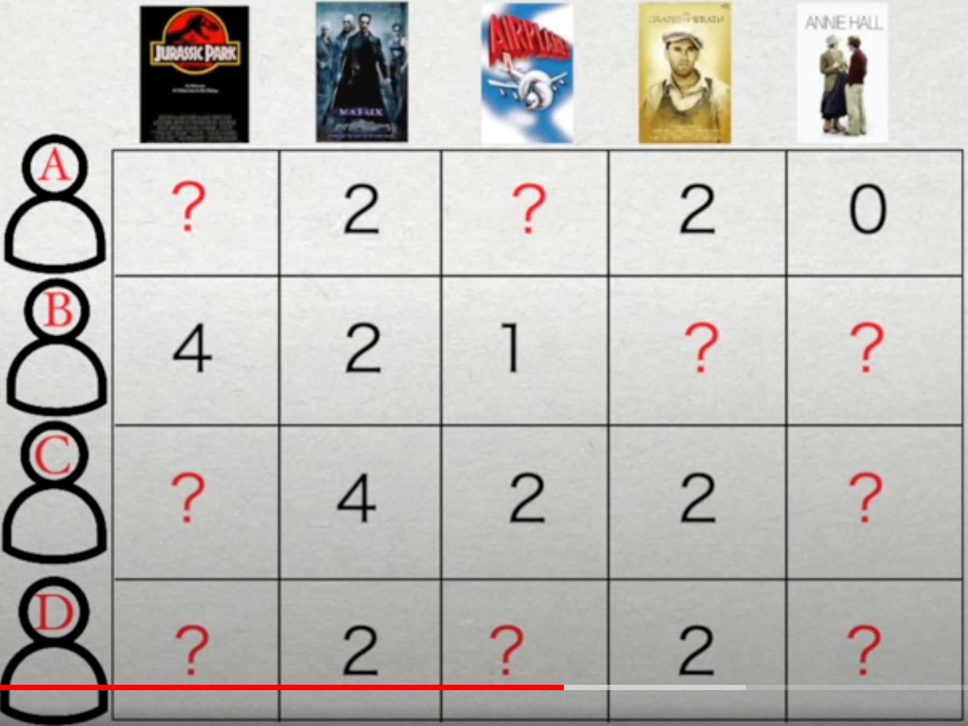
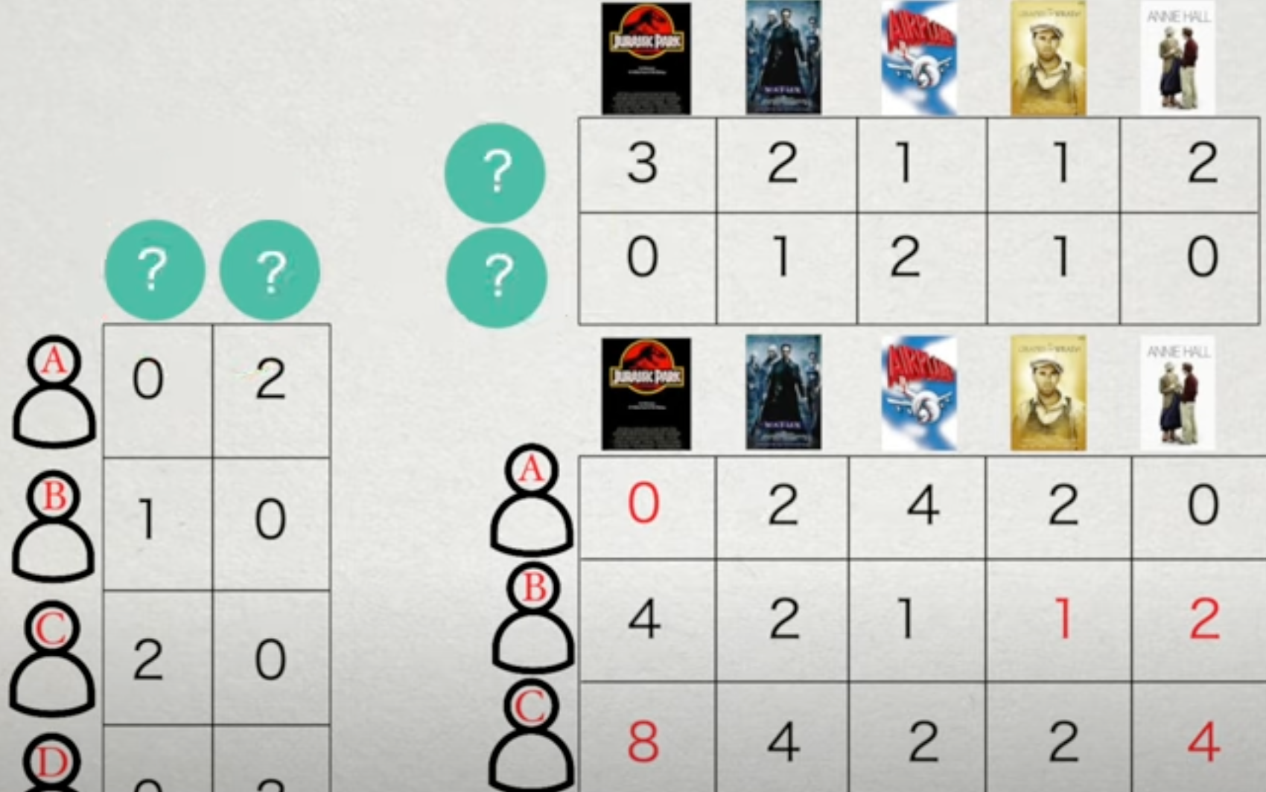
Recommender Systems (Recap)
[3, 0] is 2-D Movie-flavor embedding for movie “Jurassic Park”
[0, 2] is 2-D user-taste embedding for User A
Movie Embeddings
Start with [User, Movie] rating Matrix (X) and factorize (split) it into User-taste embedding (U) vector & Movie-flavor embedding vector (M)
such that X ≅ UxM
This ML approach is Collaborative Filtering using Matrix Factorization
Now we can recommend movies where user-taste matches movie-flavor
User Embeddings
User C is likely to like Jurassic Park as the user-taste & movie-flavor has strong match
Notes:
To recap, we start with a movie rating matrix that captures user’s ratings for some of the movies. This is a very sparse matrix as a big %age of cells will be unknown.
We use “matrix factorization” algorithm to split this matrix into two separate matrices such that when we multiply these 2 matrices we get a matrix that is very close to the original user-rating matrix, for the known user ratings. This is called Matrix Factorization.
Now we can use these user-embedding and movie-embeddings matrices (click) to fill the blanks in the original User-Rating matrix. This way we can predict whether a user will like a movie or not based on how well the movie’s flavor matches user’s taste.

Slide 8

Generative AI: GANs (Generative Adversarial Networks)
Aladdin Persson
Notes:
In the last few years, Generative AI has become very popular, and sparked concerns about deep fakes.
In this video we will learn how we can train an ML model to be “creative”.
(click to play video)

Slide 9
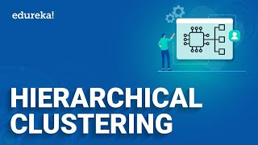

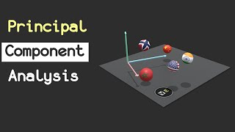
Further Reading / Watching / Doing
Hierarchical Clustering
Reinforcement Learning
PCA - Dimensionality Reduction
Notes:
For this week, I have not made a hands-on exercise. To learn about concepts like hierarchical clustering, dimensionality reduction and reinforcement learning, check out these videos.

